Slide 1
Team Name- MODYfyers Team Members- Shatakshi Singh, Shalini Agrawal, Ritika Sethi, Harshita Das College- Mody University of Science and Technology, Lakshmangarh, Rajasthan

Slide 2
PROBLEM STATEMENT
Rapid Detection of COVID-19 using Lung X-Ray.
The test of Covid-19 is currently done by Reverse Transcriptase -Polymerase Chain Reaction (RT-PCR) which is time-consuming and the number of test kits are limited . Hence, in most cases the diagnosis is taking time and hence, the disease is spreading rapidly.
We aim to leverage Artificial Intelligence methodologies to develop a system for rapid detection of COVID-19 using Lung X-ray image.

Slide 3
SOLUTION
The AI model here is trained with Chest X-ray images of Covid-19 positive patients and health lungs.
VGG-16 architecture is used for applying transfer learning, using Tensorflow 2.3.0 and Keras 2.3.5.
The trained model is then being deployed to a web application which is built with Python 3.6 and flask in back-end and HTML and CSS in front-end.
Our application will not only provide result at a faster speed but will be much economical. Moreover , this can be done at smaller labs where only X-Ray facility is available. Sample for RTPCR are sent elsewhere.

Slide 4








TECH STACK
Flask
Keras
TensorFlow
HTML5
CSS
Python
Colab
OpenCV
Scikit learn

Slide 5
USE CASE DIAGRAM
Upload Image
CLIENT
SERVER
Response
Store Image
Preprocess Image
Send it to source model
Generates Result

Slide 6

MARKET ANALYSIS
Deliverable Outcomes
Research
It targets large number of users from a child to an elderly person. With 97% accuracy rate, it will provide the result in just few minutes. Currently it is the hot demand of any diagnostic laboratory.
We did a research on Aritificial Intelligence methods for classification of COVID-19 +ve and –ve X-ray images. We experimented with different Transfer Learning Models and found VCG-16 to be most suitable.
Budget
Collaboration
It requires a high configuration system to train our model with more images for increasing generalizability of the model. We are looking for hardware support from different research labs
Once the project is developed we plan to collaborate with leading diagnostic and pharmaceutical laboratories for validation of our project and for more dataset.

Slide 7
FLOW CHART
Setting up Environment
Installing necessary libraries, framework etc
Collected data of Lung X-rays from different resources and performed data cleaning
Data Collection & Cleaning
Training Model
Used VGG-16 Architecture
Made a user convenient UI for deploying our project
Frontend & Backend
Compile the project & host it

Slide 8
IMPLEMENTATION
TRAINING OF MODEL: Model training was done on Google Colab cloud platform.
DEPLOYING: The model is currently being deployed on local host using Flask API. Once the application is developed and approved by the authorized research labs, it will be deployed on cloud as website for use. Alternatively we can deploy the web app on a system in labs and hospitals to assist radiologist.
The Hardware configuration of server to host the app are as given below. For training the model on high resolution data:
Xeon processor (16 core) , 64 GB RAM , Nvidia Quadro RTX 5000 GPU card , 4 TB Hard Disk Space.
For hosting the web app (Co located with X-Ray machine) :
PC with i7 processor/8GB RAM/ 500 GB HDD, Operating system Linux.

Slide 9
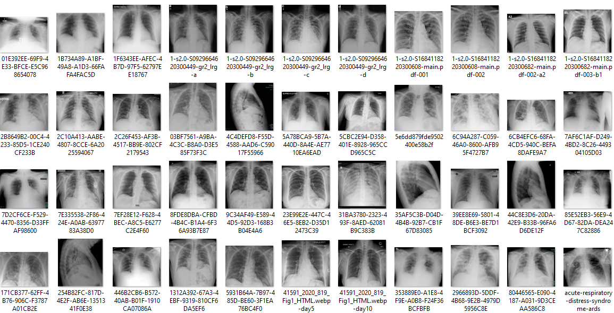
SCREENSHOTS/IMAGES
Dataset Samples

Slide 10
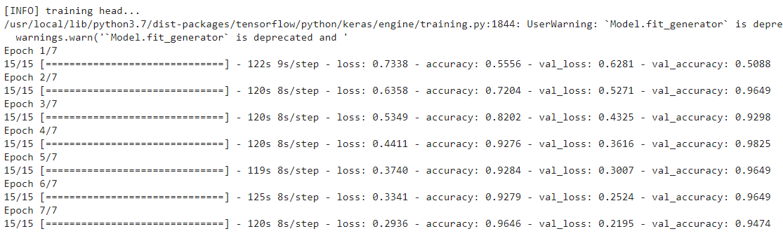
Training Epochs

Slide 11
THANK YOU

